Slide 1
SI206 Discussion 11 JSON

Slide 2
Reminders
Final project plans due in 2 weeks – time to find a group!
2-3 students
Instructions are up on Canvas

Slide 3
Reading JSON
json.loads(string) : JSON -> Python object
Takes a JSON string and return a Python object (list or dictionary)
json.dumps(obj) : Python object -> JSON
Takes a Python object and returns a JSON string

Slide 4
Reading JSON from a File
Open the file for reading
file = open(filename, ‘r’)
Read the content into one big string
string = file.read()
Close the file
file.close()
Convert the string into a Python object
data = json.loads(string)

Slide 5
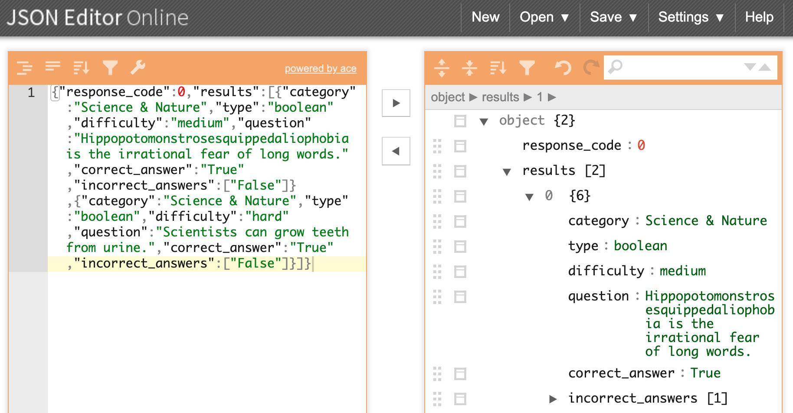
JSON Editor
JSON Editor Online : https://jsoneditoronline.org
It’s super helpful to see the structure in a readable format that you can manipulate

Slide 6
Today’s Task
Use the provided JSON document (movies.json)
TASK 1:
Write a function read_json(file) that reads a JSON document, decodes the file content, and returns a dictionary.
TASK 2:
Write a function top_movies(rated, data) that returns the top three movies based on the movie ratings category (rated) specified.
TASK 3:
Write a function get_longest_movie(data) that returns the title of the longest movie.

